Slide 1


Slide 2
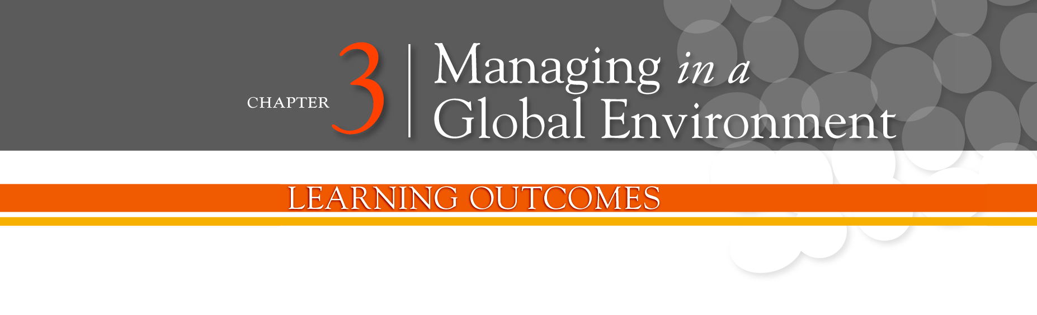
Contrast ethnocentric, polycentric, and geocentric attitudes toward global business
Discuss the importance of regional trading alliances and global trade mechanisms
Describe the structures and techniques organizations use as they go international
Explain the relevance of the political/legal, economic, and cultural environments to global business

Slide 3
What’s Your Global Perspective?
Parochialism - viewing the world solely through your own perspectives, leading to an inability to recognize differences between people.
Ethnocentric Attitude - the parochialistic belief that the best work approaches and practices are those of the home country.

Slide 4
More Global Perspectives
Polycentric Attitude - the view that the managers in the host country know the best work approaches and practices for running their business.
Geocentric Attitude - a world-oriented view that focuses on using the best approaches and people from around the globe.

Slide 5
Trading Alliances
European Union (EU) - a union of 27 European nations created as a unified economic and trade entity
Euro - a single common European currency

Slide 6
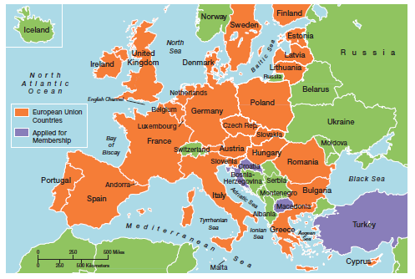
Exhibit 3-1: European Union Map

Slide 7
Trading Alliances (cont.)
Nations (ASEAN) - a trading alliance of 10 Southeast Asian nations.
North American Free Trade Agreement (NAFTA) - an agreement among the Mexican, Canadian, and U.S. governments in which certain barriers to trade have been eliminated.

Slide 8
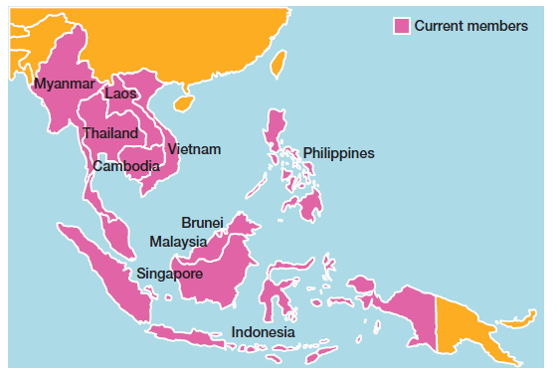
Exhibit 3-1: ASEAN Map

Slide 9
Global Trade Mechanisms
World Trade Organization (WTO) - a global organization of 153 countries that deals with the rules of trade among nations.
International Monetary Fund (IMF) - an organization of 185 countries that promotes international monetary cooperation and provides advice, loans, and technical assistance.

Slide 10
Global Trade Mechanisms (cont.)
World Bank Group - a group of five closely associated institutions that provides financial and technical assistance to developing countries.
Organization for Economic Cooperation and Development (OECD) - an international economic organization that helps its 30 member countries achieve sustainable economic growth and employment.

Slide 11
Types of International Organizations
Multinational Corporation (MNC) - a broad term that refers to any and all types of international companies that maintain operations in multiple countries.
Multidomestic Corporation - an MNC that decentralizes management and other decisions to the local country.

Slide 12
Types of International Organizations (cont.)
Global Company - an MNC that centralizes management and other decisions in the home country.
Transnational or Borderless Organization - an MNC in which artificial geographical barriers are eliminated.

Slide 13
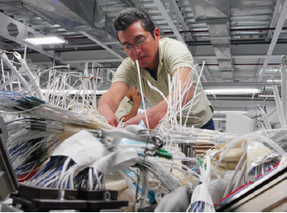
How Do Organizations Go Global?
Global Sourcing - purchasing materials or labor from around the world wherever it is cheapest.
Exporting - making products domestically and selling them abroad.

Slide 14
Going Global (cont.)
Importing - acquiring products made abroad and selling them domestically.
Licensing - an organization gives another organization the right to make or sell its products using its technology or product specifications.
Franchising - an organization gives another organization the right to use its name and operating methods.

Slide 15
Going Global (cont.)
Strategic Alliance - a partnership between an organization and one or more foreign company partner(s) in which both share resources and knowledge in developing new products or building production facilities.
Joint Venture - a specific type of strategic alliance in which the partners agree to form a separate, independent organization for some business purpose.

Slide 16
Going Global (cont.)
Foreign Subsidiary - directly investing in a foreign country by setting up a separate and independent production facility or office.

Slide 17
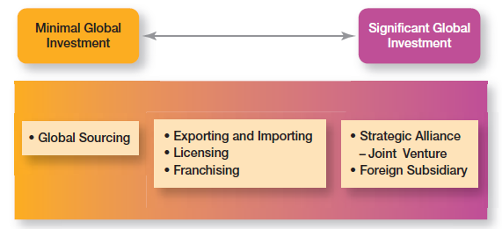
Exhibit 3-3: How Organizations Go Global

Slide 18
The Economic Environment
Free Market Economy - an economic system in which resources are primarily owned and controlled by the private sector.
Planned Economy - an economic system in which economic decisions are planned by a central government.

Slide 19
The Cultural Environment
National Culture - the values and attitudes shared by individuals from a specific country that shape their behavior and beliefs about what is important.
Global Leadership and Organizational Behavior Effectiveness (GLOBE) program - a research program that studies cross-cultural leadership behaviors.

Slide 20
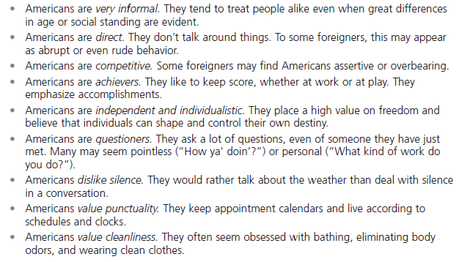
Exhibit 3-4: What Are Americans Like?

Slide 21
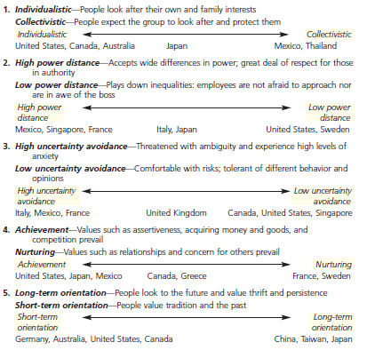
Exhibit 3-5: Hofstede’s Five Dimensions of National Culture

Slide 22
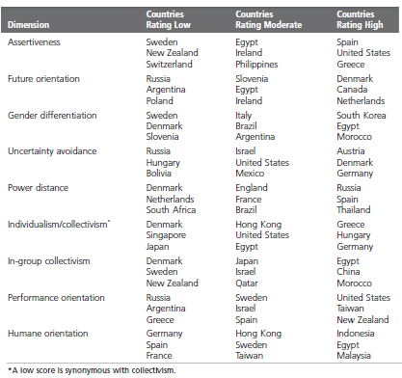
Exhibit 3-6: Globe Highlights

Slide 23
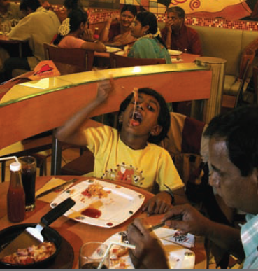
Contemporary Issues
Cultural Intelligence - cultural awareness and sensitivity skills.
Global Mind-Set - attributes that allow a leader to be effective in cross-cultural environments.

Slide 24
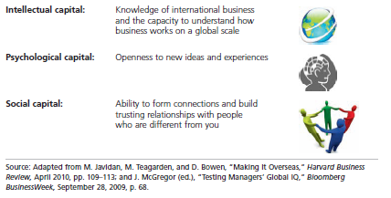
Exhibit 3-7: A Global Mindset

Slide 25
Terms to Know
Parochialism
Ethnocentric attitude
Polycentric attitude
Geocentric attitude
European Union (EU)
Euro
North American Free Trade Agreement (NAFTA)
Association of Southeast Asian Nations (ASEAN)
World Trade Organization (WTO)
International Monetary Fund (IMF)
World Bank Group
Organization for Economic Cooperation and Development (OECD)
Multinational corporation (MNC)
Multidomestic corporation
Global company
Transnational or borderless organization
Global sourcing
Exporting
Importing
Licensing

Slide 26
Terms to Know (cont)
Franchising
Strategic alliance
Joint venture
Foreign subsidiary
Free market economy
Planned economy
National culture
Global Leadership and Organizational Behavior Effectiveness (GLOBE) program
Cultural intelligence
Global mind-set

Slide 27
